Slide 1

Seven Segment Displays
Digital Electronics

Slide 2
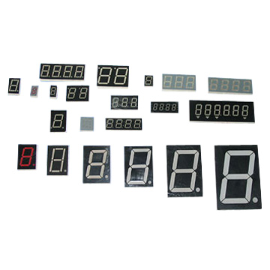
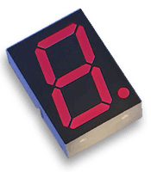
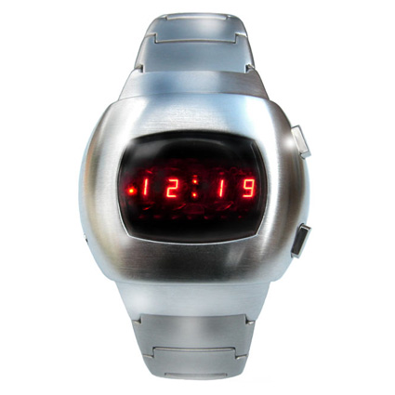
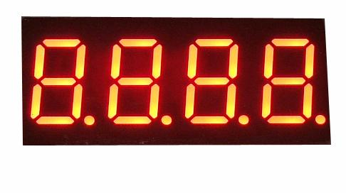
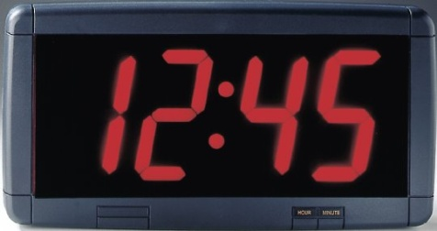
Seven Segment Displays
This presentation will demonstrate how
A seven-segment display can be used to display the decimal numbers 0-9 and some alpha characters.
A common anode seven-segment display works.
A common cathode seven-segment display works.
To select the resistor value for a seven-segment display.
Retro
LED Watch
(Circa 1970s)
Notes:
Introductory Slide / Overview of Presentation
As a class, have the students list some common everyday devices that use seven-segments displays.
http://www.avagotech.com/products/led_displays/seven_segment_displays/0.3%22_single_digit_series/hdsp-u203/
http://www.nova68.com/Merchant2/graphics/00000001/SPACEWATCH.jpg
http://www.led-signs.com/displays/led_clocks.htm
http://yhled.en.ec21.com/product_detail.jsp?group_id=GC01826620&product_id=CA01827451&product_nm=LED_Digit_Display
http://candy68.en.ec21.com/product_detail.jsp?group_id=GC02564635&product_id=CA02590117&product_nm=Sell_LED_Display

Slide 3
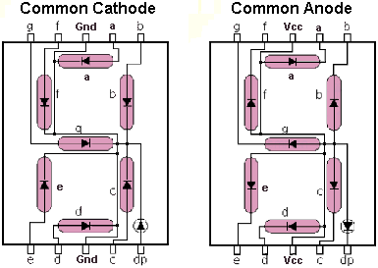
Segment Identification
A Seven-Segment Display (SSD) is simply a figure eight grouping of LEDs {some include a decimal point (DP)}.
Each Segment is labeled (a) thru (g).
SSDs are available in two configurations
  Common Cathode (all LED cathodes are connected)
  Common Anode (all LED anodes are connected)
a
f
b
g
e
c
d
dp
Notes:
The common cathode and common anode diagrams shown are typical pin layouts. They may or may not be the same as the device that the students will use to build their circuits.
http://www.thelearningpit.com/lp/doc/7seg/7seg.html

Slide 4
SSD Display Possibilities
Decimal Digits 0-9
Select Alpha Characters
Simple Messages
Notes:
Here are all of the digits that can be displayed on a seven-segment display. Also included are some alpha characters. In the activity on seven-segment displays, the student will be asked to create a few words that can be displayed on the seven-segment display.

Slide 5
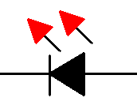
Basic LED Operations
To understand how a seven-segment display works, we must review how an LED works.
To Turn an LED ON . . .
The ANODE must be at a higher voltage potential (∼1.5v) than the CATHODE.
The amount of current flowing through the LED will determine the brightness of the LED.
The amount of current is controlled by a series resistor. (not shown)
CATHODE (‒)
(+) ANODE
← Current Flow

Slide 6
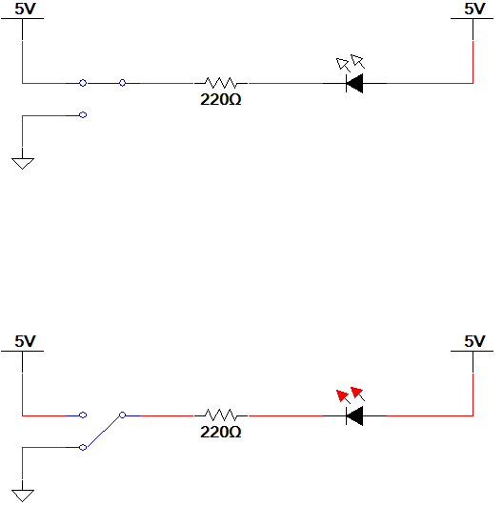
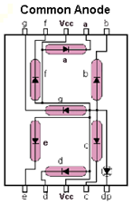
LED Configuration – Anode @ 5 Volts
Switch @ 5v
Top Circuit
LED Off
Switch @ 0v
Bottom Circuit
LED On
ANODE @ 5v
CATHODE @ 0v (nearly)
The 220 Ω resistor controls the current.
A larger resistor . . . less current . . . dimmer LED
A smaller resistor . . . more current . . . brighter LED
Common Anode
Configuration (5v=Off / 0v=On)
Notes:
In summary, common anode SSD have a common Vcc Connection and require a logic (0) to turn on a segment.

Slide 7
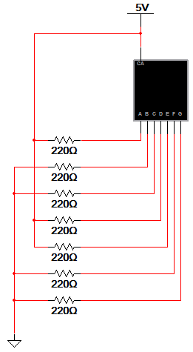
Example #1: Common Anode SSD
Example
  What value would be displayed in the common anode seven-segment display shown?
Notes:
Pause the presentation and allow the students to work on the example. The solution is on the next slide.

Slide 8
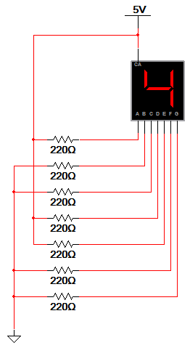
Example #1: Common Anode SSD
Example
  What value would be displayed in the common anode seven-segment display shown?
Solution
  Common Anode:
      0 volts = Segment On
        b, c, f, & g
      5 volts = Segment Off
        a, d, & e
a
f
g
b
e
c
d
Notes:
Here is the solution. If you print handouts, do not print this page.

Slide 9
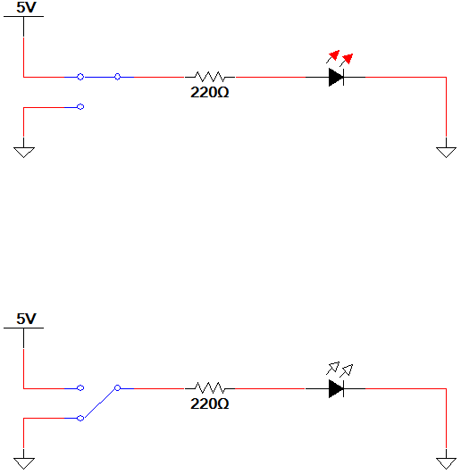
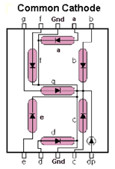
LED Configuration – Cathode @ Ground
Switch @ 5v
Top Circuit
LED On
ANODE @ 5v (nearly)
CATHODE @ 0v
The 220 Ω resistor controls the current.
A larger resistor . . . less current . . . dimmer LED
A smaller resistor . . . more current . . . brighter LED
Switch @ 0v
Bottom Circuit
LED Off
Common Cathode SSD Configuration (5v=On / 0v=Off)
Notes:
In summary, common cathode SSD have a common GND connection and require a logic (1) to turn on a segment.

Slide 10
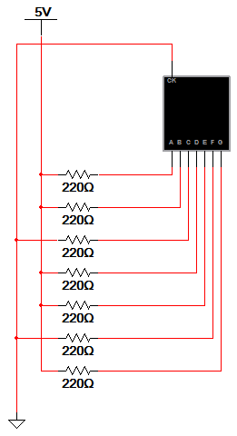
Example #2: Common Cathode SSD
Example
  What value would be displayed in the common cathode seven-segment display shown?
Notes:
Pause the presentation and allow the students to work on the example. The solution is on the next slide.

Slide 11
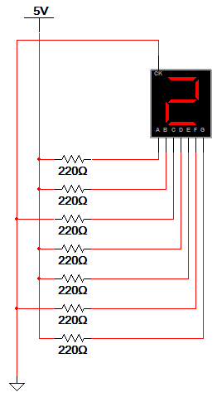
Example #2: Common Cathode SSD
Example
  What value would be displayed in the common cathode seven-segment display shown?
Solution
  Common Cathode:
      5 volts = Segment On
        a, b, d, e, & g
      0 volts = Segment Off
        c & f
a
f
g
b
e
c
d
Notes:
Here is the solution. If you print handouts, do not print this page.

Slide 12
Resistor Values for SSD
The resistor value determines the amount of current that is flowing through the LED in the SSD.
This is why they are sometimes called current limiting resistors.
The amount of current determines how luminous (bright) the LED will be.
If the resistor is too large, the current will be too small and the LED will not be visible.
If the resistor is too small, the current will be too large and the LED will be damaged.
So, how do you select the correct value? You must read the data sheet for the SSD that you are using.
Notes:
This slide discusses the importance of the current limiting resistors and the results of selecting a resistor that is too large or too small.

Slide 13
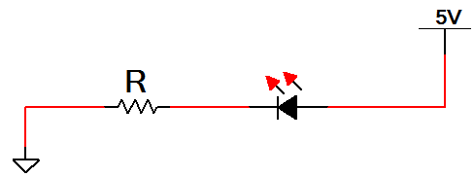
A Review of Circuit Theory
The diagram below is a single segment of a common anode seven-segment display.
The voltage across the LED (when on) is 1.5 volts.
Using Kirchhoff's Voltage Law, we know that the voltage across the resistor is 3.5 volts (i.e., 5v – 1.5v = 3.5v).
Thus, using Ohm’s Law, we can calculate the value of the resistor if we know the current that is to flow through the LED.
← I
Notes:
This slide uses Kirchhoff’s Voltage Law and Ohm’s Law to develop an equation to calculate a resistor (R) given a desired current (I).

Slide 14
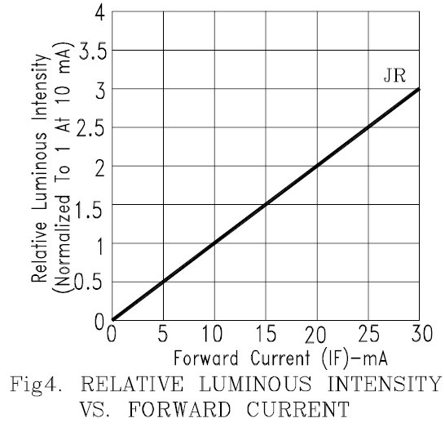
Selecting A Resistor Value
LTS-4801JR Common Anode Seven-Segment Display
Luminous Intensity vs. Forward Current Graph
Let’s arbitrarily pick a luminous intensity of 1.5 (not too bright, not too dim).
From the graph, we need a current of 15mA.
Using Ohm’s Law :
Notes:
In this example the luminous intensity was arbitrarily selected at 1.5. For the LTS-4801 JR Common Anode SSD, a current level of 15 mA would be required (from graph). Using the equation developed, the resistor value can be calculated.

Slide 15
Example #3: Resistor Value
Example
  Calculate the resistor value required to have a luminous intensity of 2.5.
Notes:
Pause the presentation and allow the students to work on the example. The solution is on the next slide.

Slide 16
Example #3: Resistor Value
Example
  Calculate the resistor value required to have a luminous intensity of 2.5.
Solution
  From the graph, we need a current of 25mA.
  Using Ohm’s Law :
Notes:
Here is the solution. If you print handouts, do not print this page.

